Slide 1
CLASS –I ENGLISH
A KITE [POEM]

Slide 2
READ ALOUD AND ENJOY
I OFTEN SIT AND WISH THAT I
COULD BE A KITE UP IN THE SKY,
AND RIDE UPON THE BREEZE AND GO
WHICH EVER WAY I CHANCED TO BLOW.

Slide 3
WHAT ARE THE DIFFERENT THINGS YOU SEE IN THE SKY
SUN

Slide 4
STAR

Slide 5
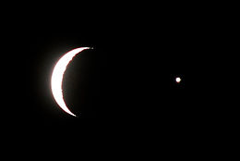
MOON

Slide 6
CLOUDS

Slide 7
RAINBOW

Slide 8
BIRDS

Slide 9
AEROPLANE

