Slide 1
Class I – English
PREPARED BY SMT. T.P.BINDU HEADMISTRESS
K.V.NO.2 KASARAGOD

Slide 4
elephant

Slide 5
New Words
1.Pain
2.Shop
3.Pant
4.Trick
5.Wet

Slide 6
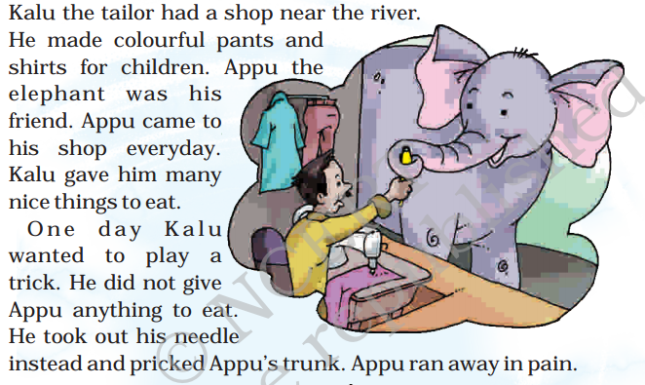

Slide 7
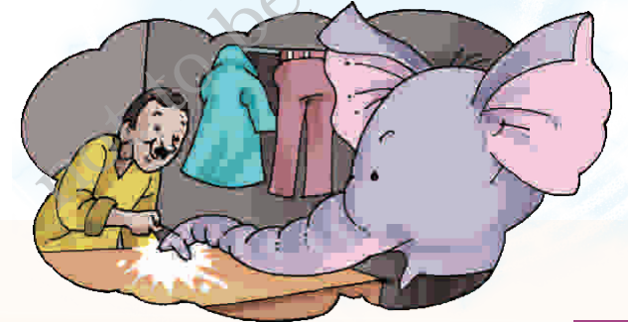

Slide 8
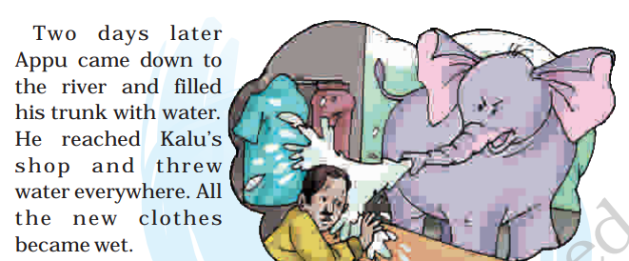

Slide 9
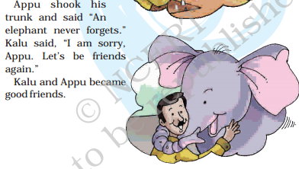

Slide 10
ANSWER THESE QUESTIONS:
1.Who was Kalu?
2.Who was Appu?
3.Where was Kalu’s shop?
4.What trick did Kalu play on Appu?
5.How did Kalu’s clothes become wet?

