Slide 1
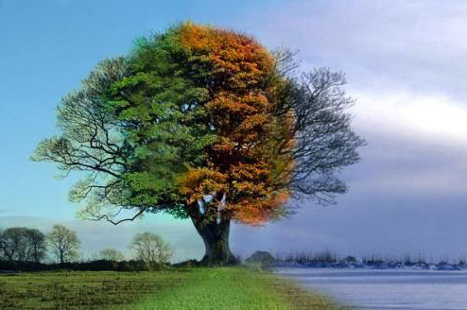
seasons
Prepared By
Mrs.Ramya C B PRTkVPayyannur
Mrs.Rekha V V
PRTKVPayyannur

Slide 2
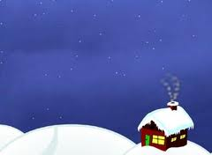
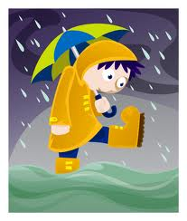
There are three seasons
Winter
Summer
Rainy

Slide 3
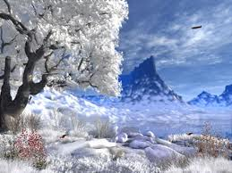
Winter Season
It Is the coldest season .

Slide 4
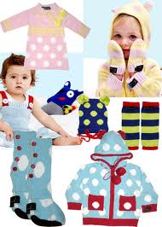
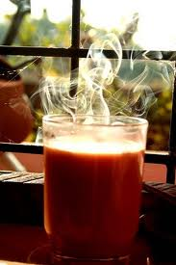
During winter season people wear woolen dress like sweater, socks ,monkey Cap etc.
People Like to eat hot food items.

Slide 5
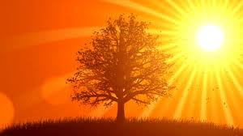
Summer Seasons
Long hot days.

Slide 6
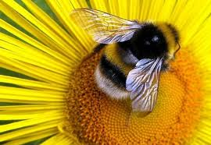
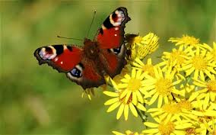
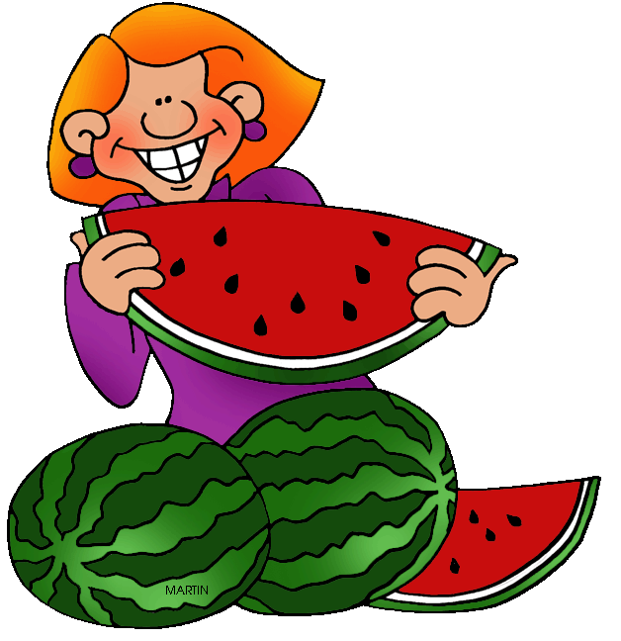
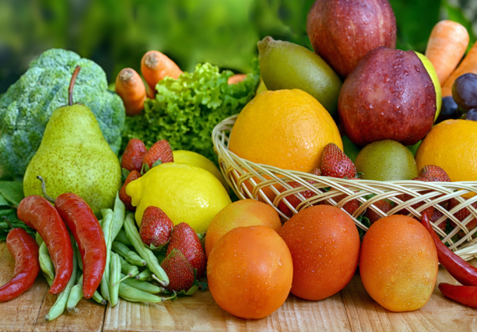
We can see so many bees and butterflies and fly flower to flower.
Summer fruits and vegetables are ready to be picked.

Slide 7
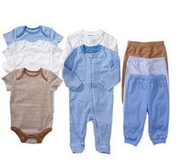
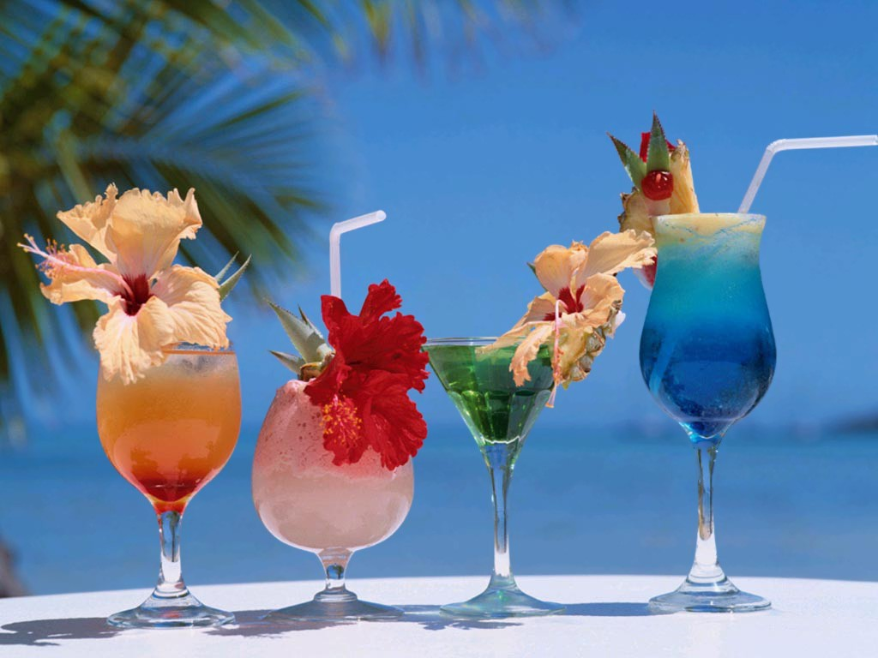
Things used in Summer Season
Cotton Clothes
Cool drinks

Slide 8
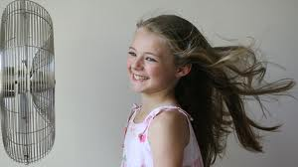
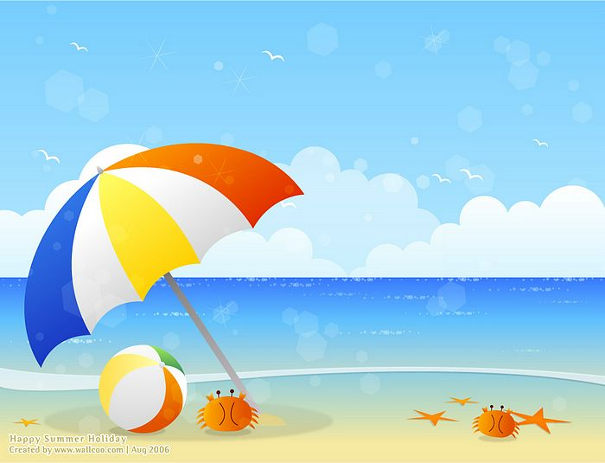
Things used in Summer Season
Fan
Umbrella

Slide 9
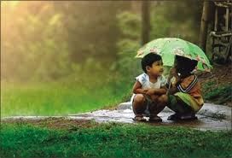
Rainy Season

Slide 10
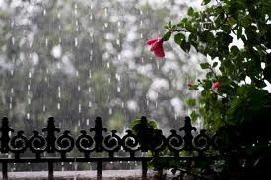
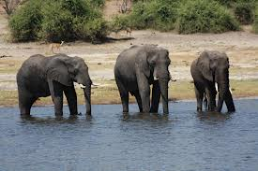
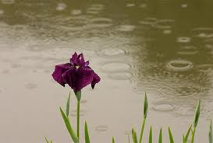
Plants and animals get water.
Rivers, ponds and lakes will be filled with water

Slide 11
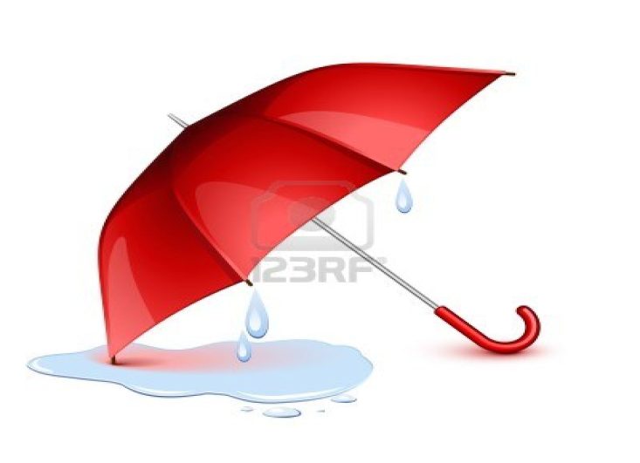
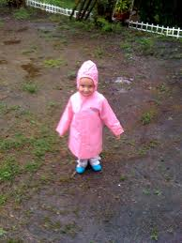
Things used in rainy season
Umbrella
Rain coat

Slide 12
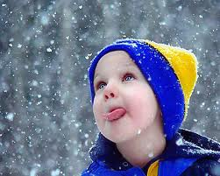
Cap
Hot drinks and hot food

Slide 13
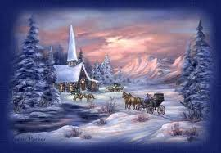
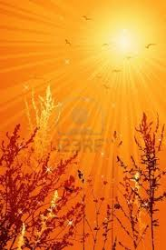
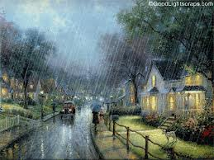
Name the Season

Slide 14
Match the following
Summer Rain Coat
Winter Cotton clothes
Rainy Woolen clothes

Slide 15
Thank You

