Slide 1
SUNDARI
CLASS -I- ENGLISH

Slide 2
READ ALOUD
SUNDARI WAS A BIG RED, WHITE & BLUE KITE.

Slide 3
BOBBY MADE SUNDARI.
BOBBY SAID – YOU ARE BEAUTIFUL AND I WILL CALL YOU SUNDARI

Slide 4
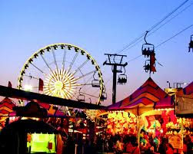
ONE DAY BOBBY TOOK SUNDARI TO THE FAIR.
FAIR

Slide 5
BOBBY HELD HIS KITE UP AS HIGH AS HE COULD.
SUNDARI STARTED TO FLY UP.

Slide 6
A LITTLE DOG WAS HOLDING ON HER TAIL. SO SHE COULD NOT GO VERY HIGH.

Slide 7
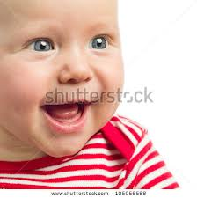
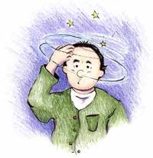
New word
Smile
Dizzy

Slide 8
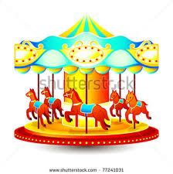
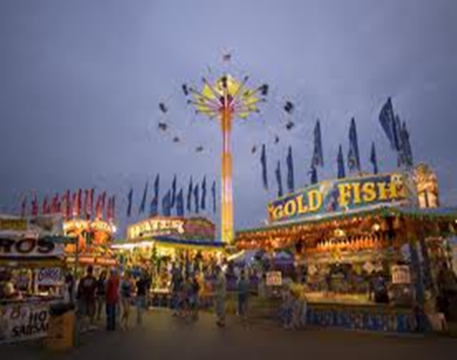
Merry-go-round
Fair(mela)

Slide 9
String(of a kite)

Slide 10
Now read these aloud
Dizzy .- I feel dizzy on a merry-go-round the band was playing a tune.
I went for a fair with my parent.
The kite has a string .
smile please

