Slide 1
Class I Sub: Mathematics
Lesson
Measurement

Slide 2
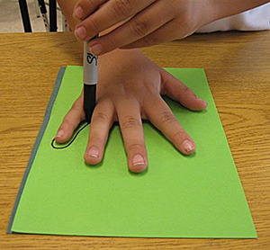
Assesment tools for evaluation Graded Questions C Grade Questions
Trace your hand span and color it

Slide 3
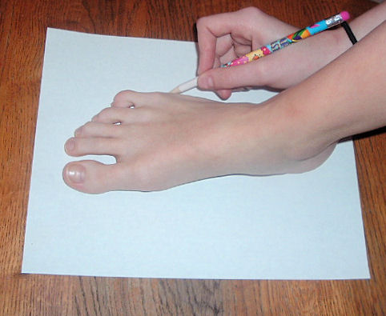
Trace your friend’s foot

Slide 4
Measure the Pencil

Slide 5
Measure your book

Slide 6
Measure the table

Slide 7
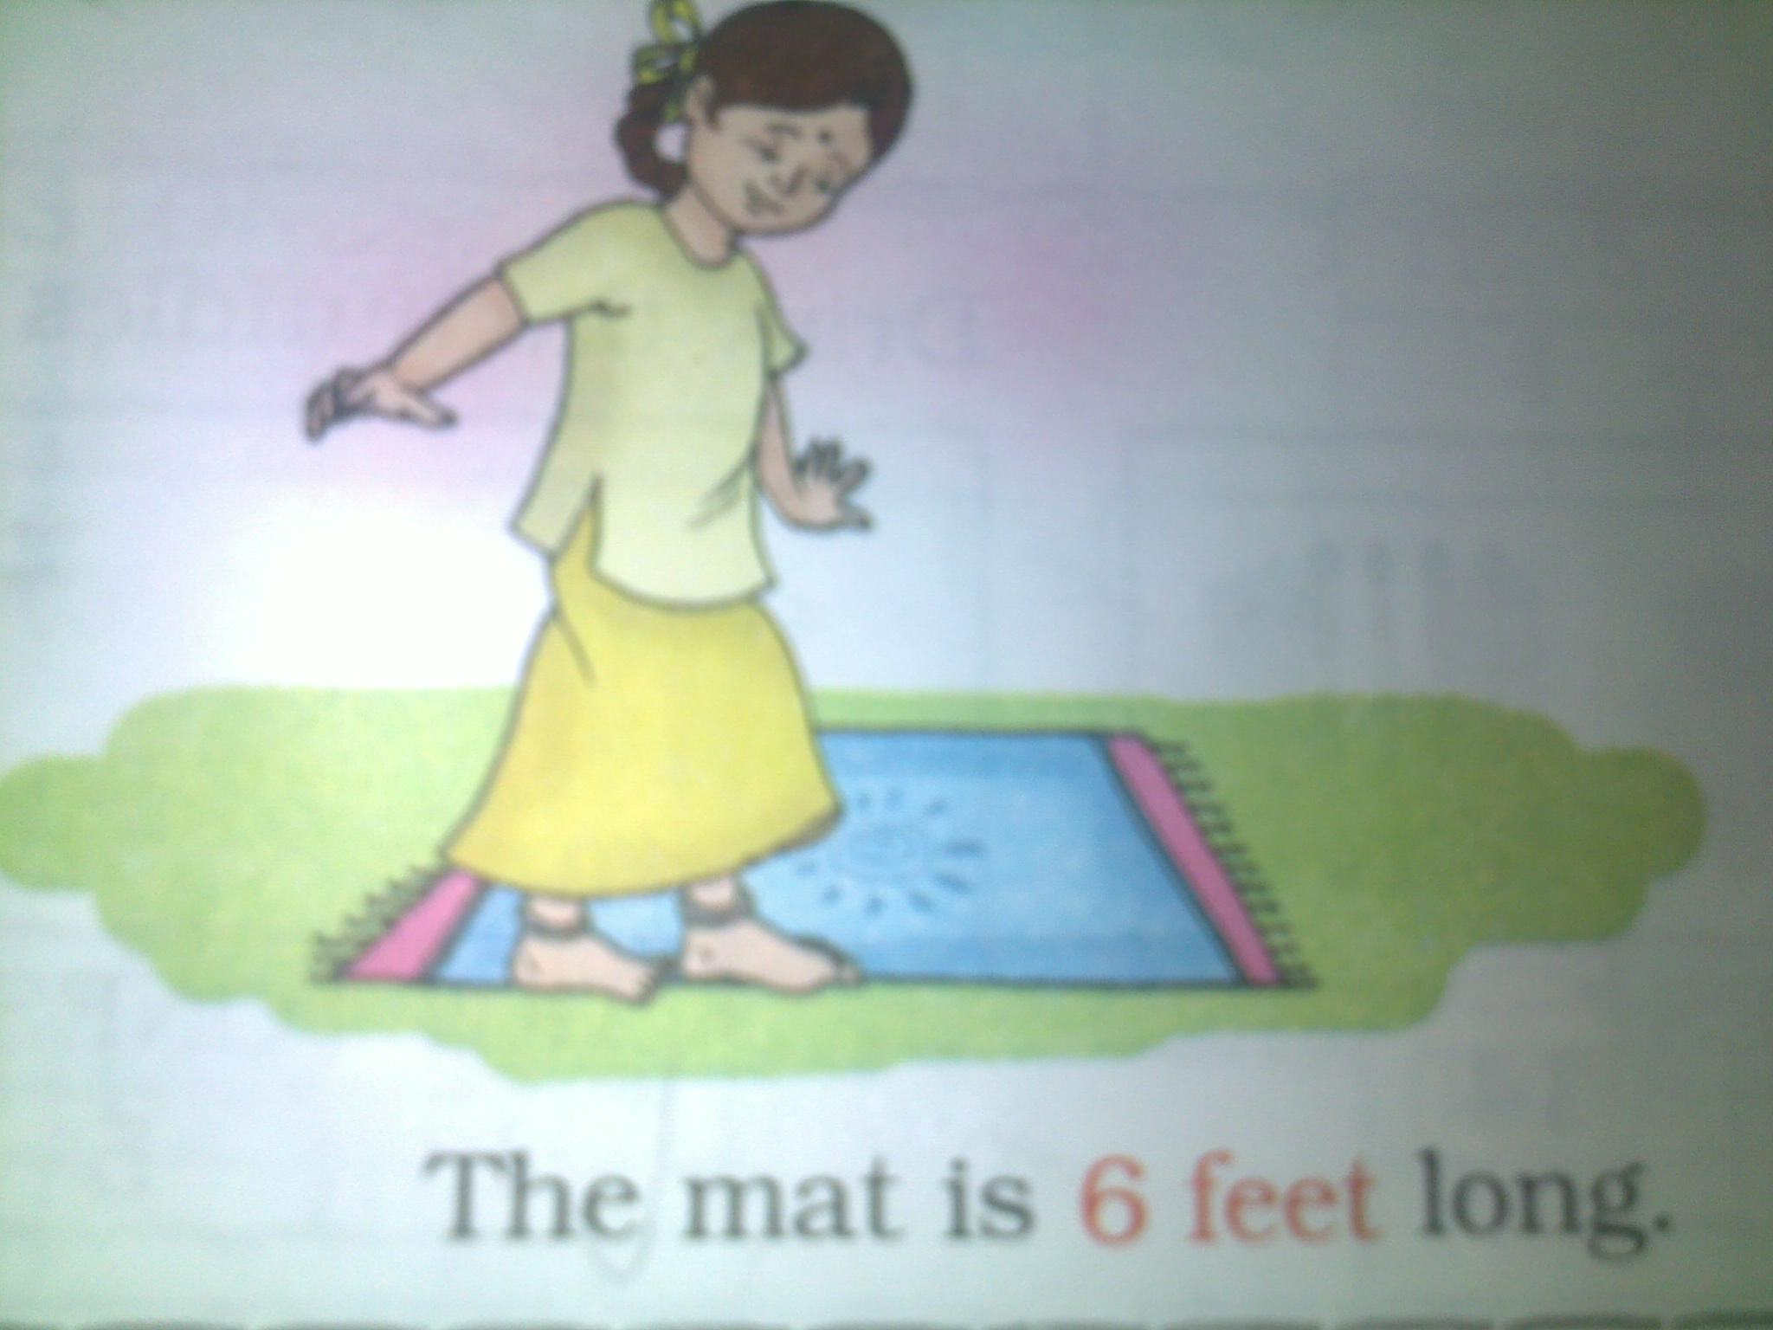
B Grade Questions
Measure the class mat

Slide 8
Measure the length of the black board

Slide 9
Measure the distance between chairs using feet

Slide 10
Which measure is used to find the length of the following things? (tick the correct answer)
Things | Hand Span | Feet | Finger
Bat
Bag
Match Box
Carpet
Teacher's Table
Mat
Nose
Friend's Hand

Slide 11
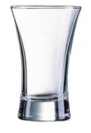
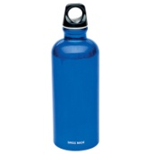
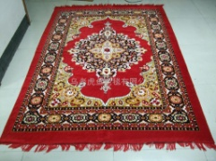
A Grade Questions
Guess the length or height of the things. Find the length to check your answer
Name of the thing | My Guess | My Result
Glass | ________ Fingers | ________ Fingers
Teacher’s Table | ________ Hand Span | ________ Hand Span
Water Bottle | ________ Fingers | ________ Fingers
Rama’s Hair | ________ Hand Span | ________ Hand Span
Carpet | ________ Feet | ________ Feet

Slide 12
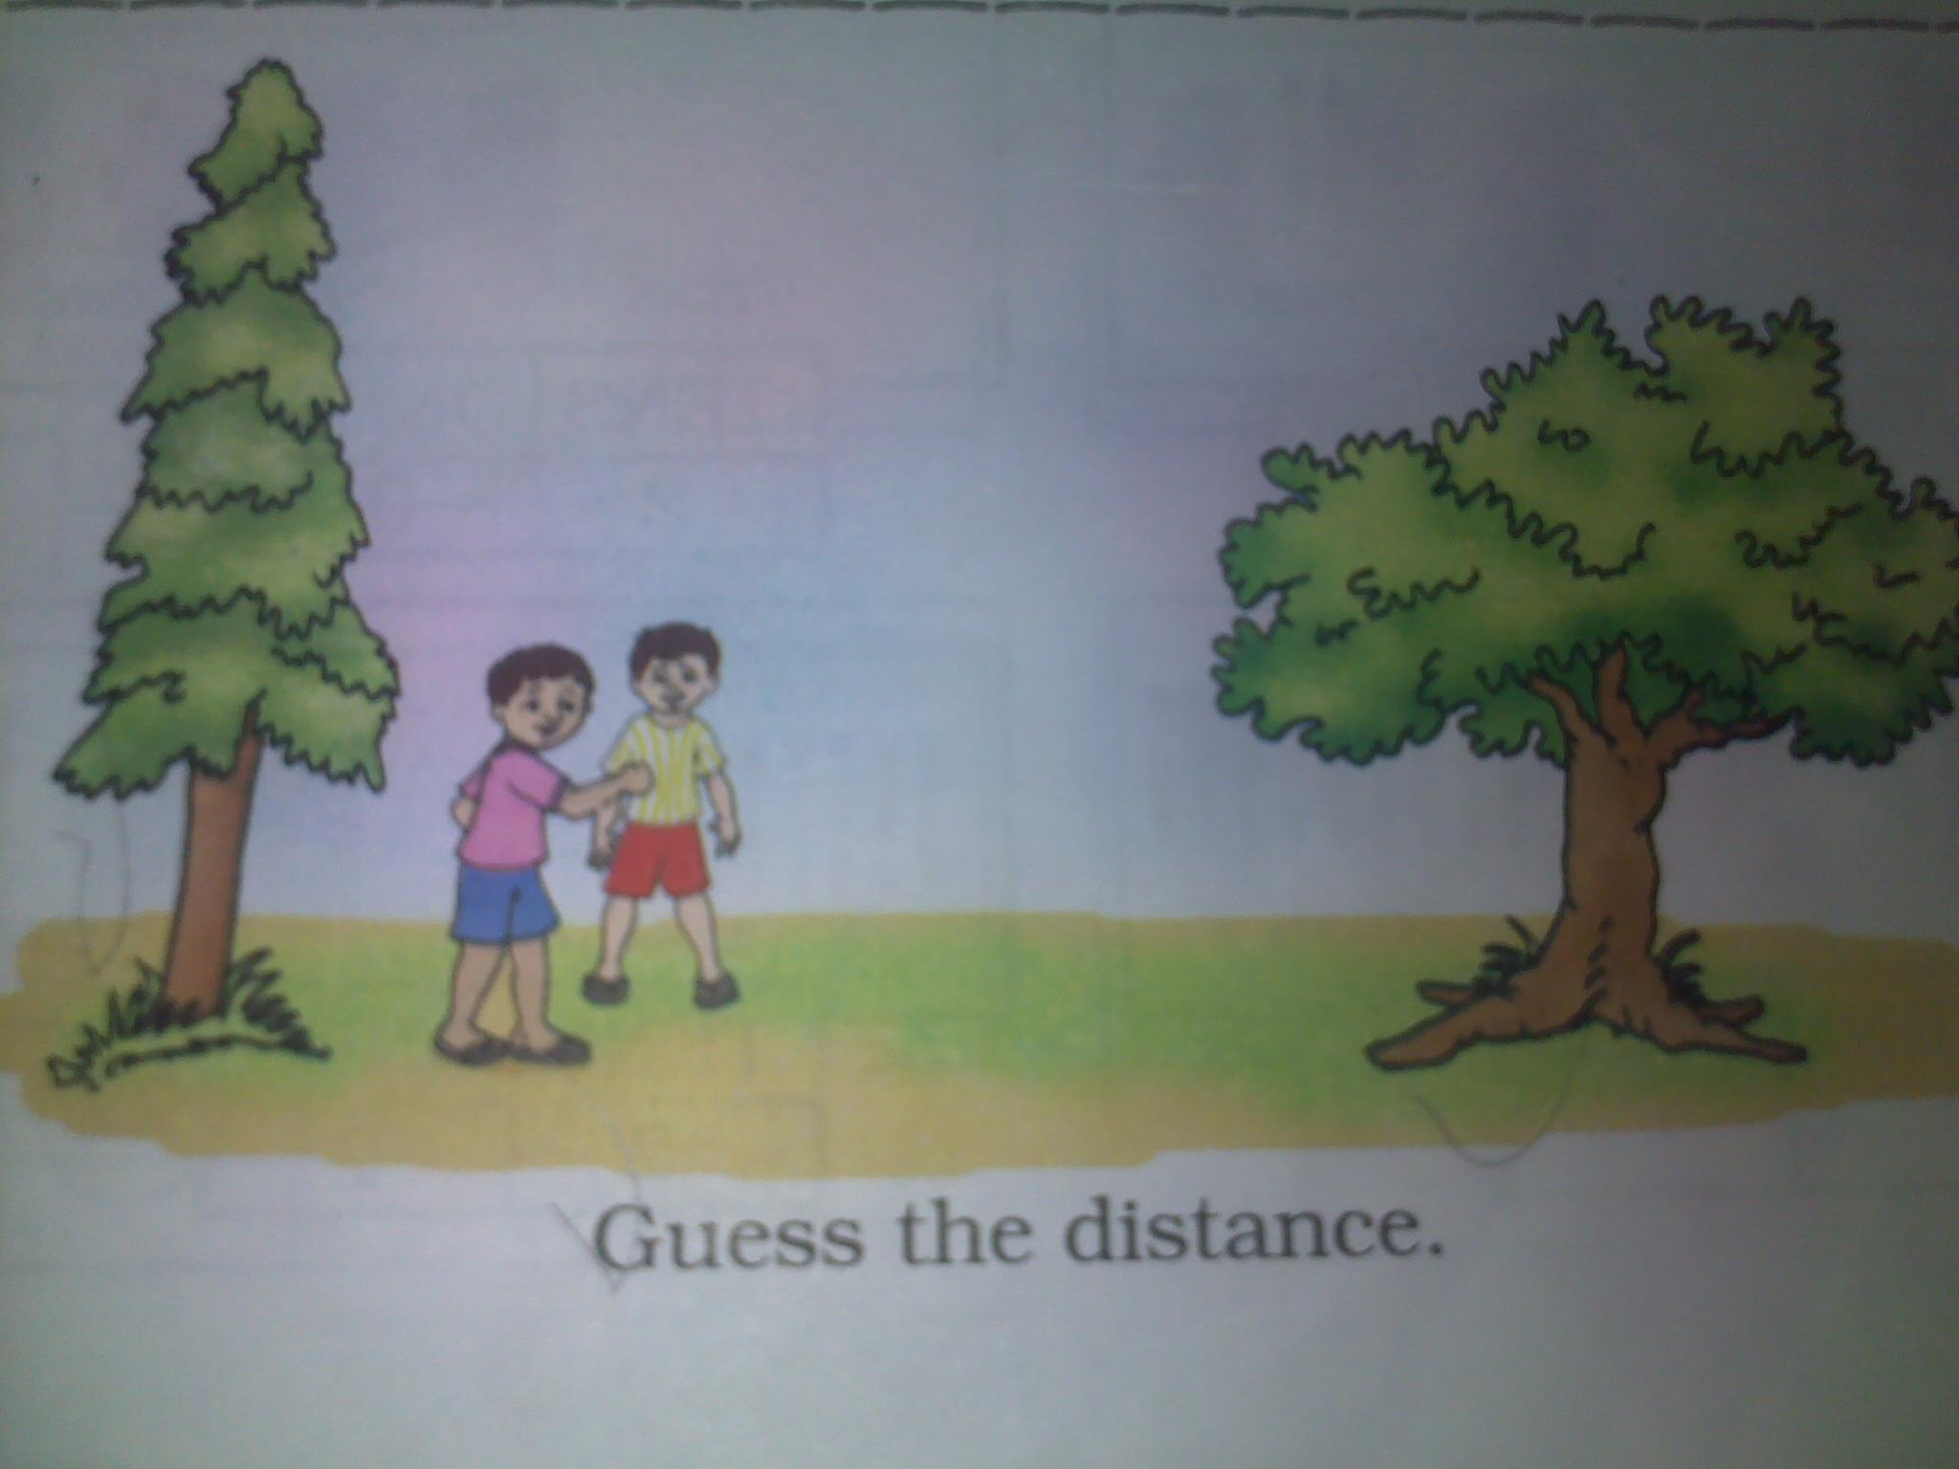
Guess the distance between the 2 trees and find the actual distance in feet

Slide 13
Draw a leaf 2 fingers away from the ball
Draw a bat 5 fingers away from the ball
Draw a kite 2 hand spans away from the ball
Draw a bird 4 fingers away from the ball

