Slide 1
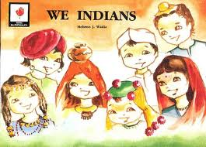
National Integration
MCB unit 6
Class X
Prepared by:
Soniya Joseph,
TGT Eng,
K.V.No.1 CPCRI KASARAGOD

Slide 2
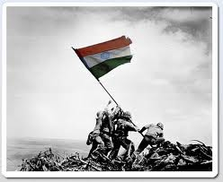
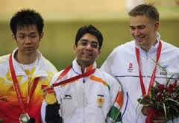
Our patriotic sense and national consciousness are triggered on occasions like:
When the national flag was hoisted on Mount Everest for the first time on 29 May 1953
When the national anthem was played during Olympics
Mention a few more such occasions…

Slide 3
Multi lingual, multi cutural……
costume
caste
cuisine
India- a multitude of
creed
culture
colour

Slide 4
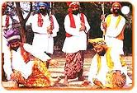
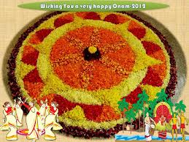
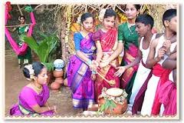
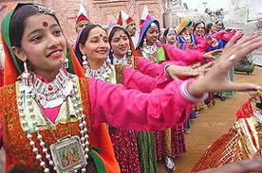
Unity in Diversity
Travel across India, you’ll find commonalities like:
Festivals dedicated to seasons and harvest though they vary from culture to culture , region to region.
Which is the festival associated with ‘harvest’ celebrated in your locality?

Slide 5
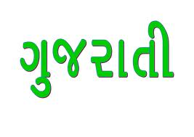
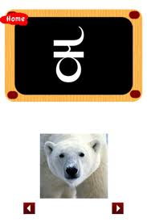
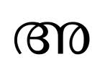
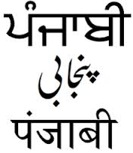
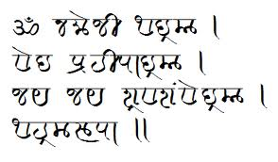
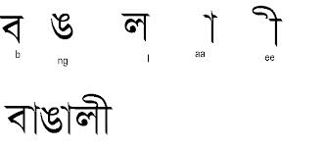
Can you name at least 15 languages spoken in India?

Slide 6
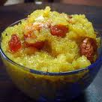
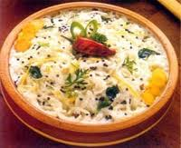
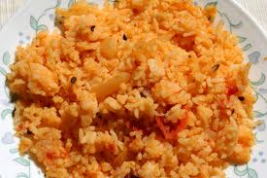
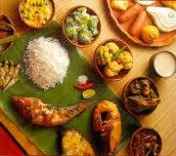
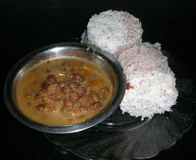
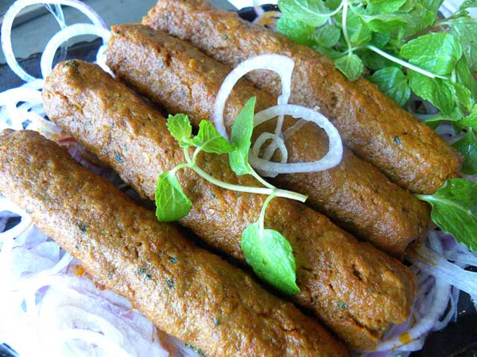
Name 10 dishes available at various states in India, for e.g..
Pongal- Tamilnadu
What is meant by
CUISINE /kwizi:n/ ?

Slide 7
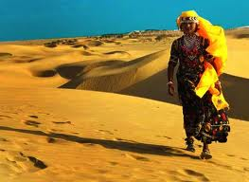
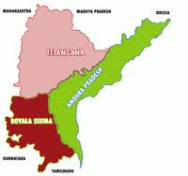
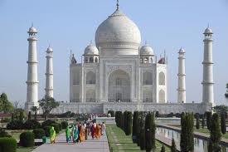
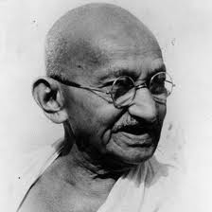
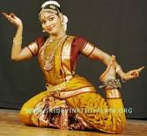
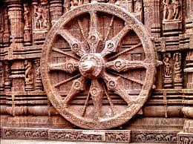
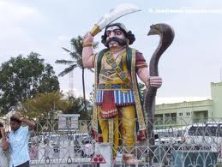
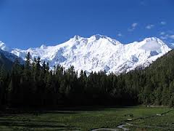
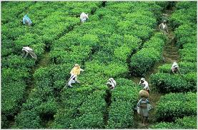
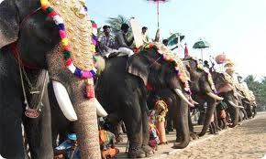
Let’s play a game….
Name the state to which the given picture is associated with:
Answers
U.P 2. T.N 3. Assam 4. Gujrat 5. J&K 6. Kerala 7. Rajastan 8. Orisa 9. A.P 10. karnataka

Slide 8
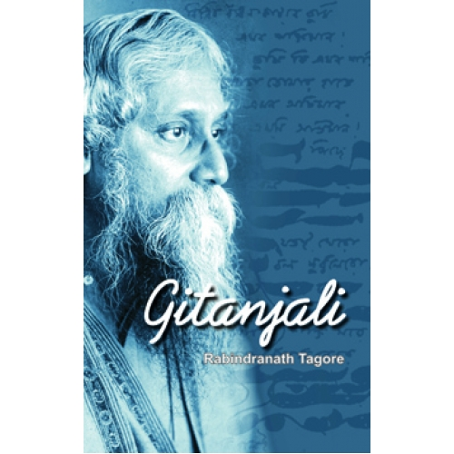
In a verse from ‘GITANJALI’
Tagore prays the almighty to lead his country to a state which is free from NARROW DOMESTIC WALLS and DREARY DESERT SAND OF DEAD HABITS.
Let’s discuss…
1. what are the narrow domestic walls refer to?
2. why are they narrow?
3. what are the dead habits? what is symbolised by dreary desert ?
(keep in mind: terrorism, castism…, selfish, nonprogressive, social evils, do not cause any development..)

Slide 9
Read the extract of Dr. Kalam’s childhood taken from his “Wings of Fire”
Major points:
His best friends were from Hindu Brahmin families. As Children, none of them ever felt any difference among themselves because of their religious differences
His father used to provide all aids for the local temple festivals. – communal harmony
Kalam possessed positive qualities of honesty, free thinking, hard work etc.

Slide 10
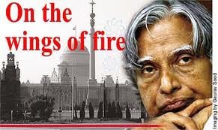
The country needs more and more people like kalam’s science teacher Sivasubramania, kalam’s mother and grandmother because they fed whoever hungry irrespective of any religious considereations. The science teacher paved way for Kalam’s progress and scientific thinking.
we should never be narrow minded like the teacher who tried to separate Kalam from the Brahmin friends.

