Slide 1
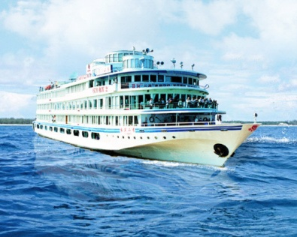
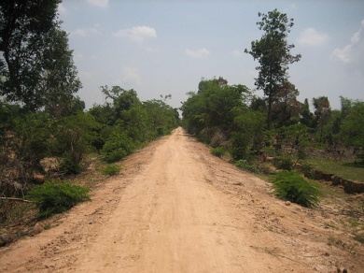
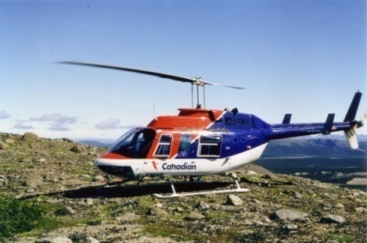
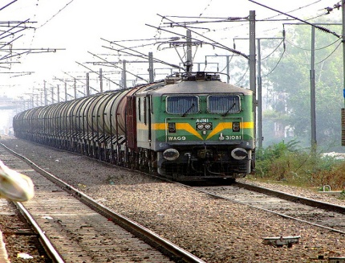
Lifelines of national economy
Geography chapter 7

Slide 2
MEANS OF TRANSPORT
LAND
ROADWAYS
RAILWAYS
PIPELINES
WATER
-INLAND
-OVERSEAS
AIR
-DOMESTIC AIRWAYS
-INTERNATIONAL AIRWAYS
-PUBLIC UNDERTAKING

Slide 3
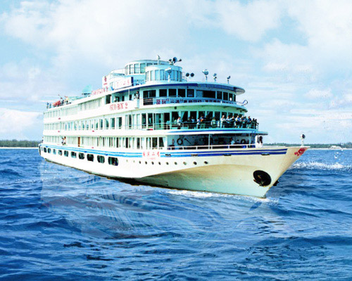
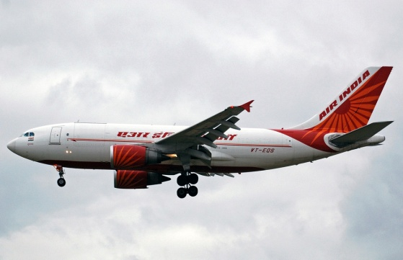
TRANSPORT

Slide 4
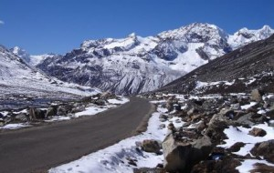
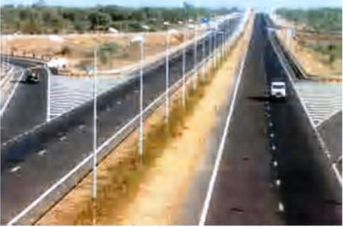
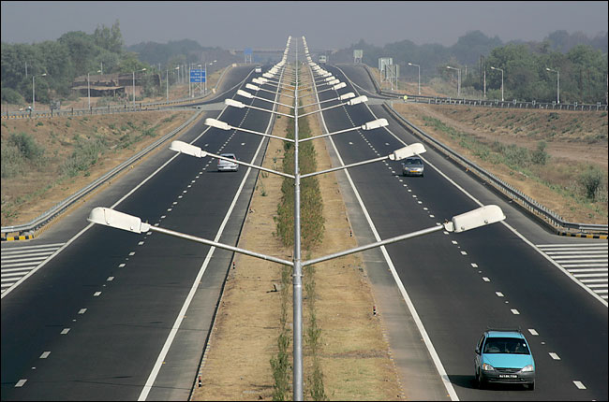
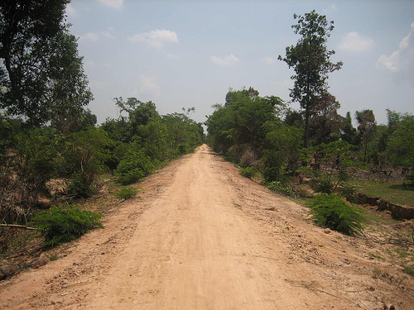
LAND WAYS

Slide 5
(i) Roadways
India has one of the largest road networks in the world, aggregating to about 2.3 million km at present. In India roadways have preceded railways.
The growing importance of road transport vis-a-vis transport is rooted in the following reasons
1) Construction of roads is much lower than that of railway lines
2) Roads can traverse comparatively more dissected and undulating topography.
3) Roads can negotiate higher gradients of slopes and as such as the Himalayas
4) Road transport is economical in transportation of few persons and relatively smaller amount of goods over short distances
In India roads are classified in the following six classes

Slide 6
Golden Quadrilateral Super Highways = The major objective of these Super highways is to reduce the time and distance between the mega cities of India . These highways are implemented by the National Highway Authority of India (NHAI)

Slide 7
National Highways = National Highways link extreme parts of the country. These are the primary road systems and are laid and maintained by the Central Public Works Department (CPWD)

Slide 8
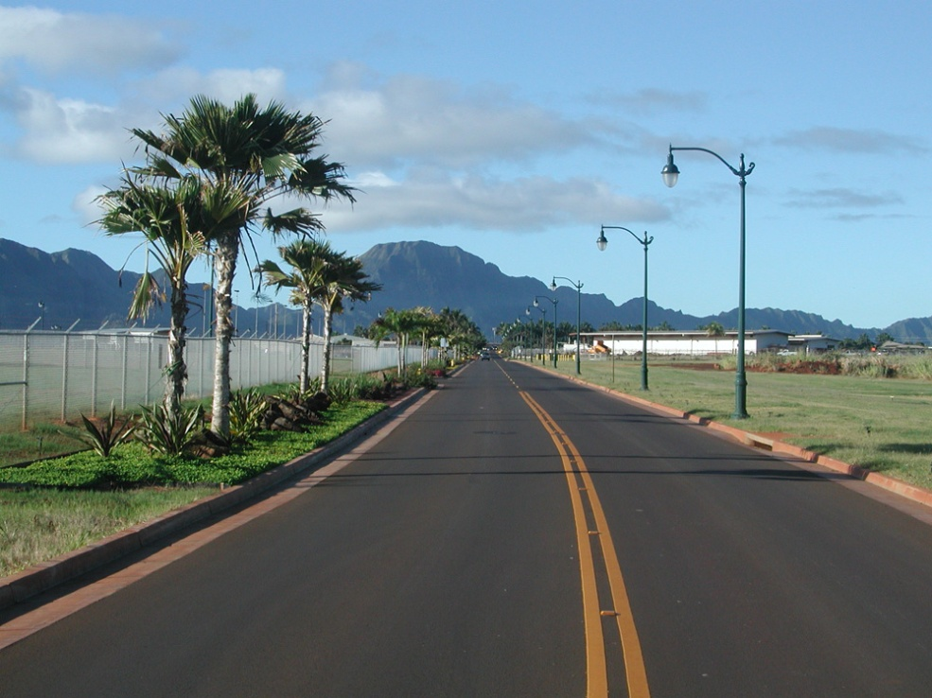
State highways= Roads linking a state capital with different district headquarters are known as state highways . These roads are constructed and maintained by the State Public Works Department

Slide 9
DISTRICT ROADS=These roads connect the district headquarters with other places of the district. Thes roads are maintained by the zila parishad.

Slide 10
OTHER ROADS= Rural roads which link rural areas and villages with towns are classified under this category.

Slide 11
BORDER ROADS= Apart from these, Border Roads Organisation a Government of India undertaking constructs and maintains roads in the borders areas of the country.

Slide 12
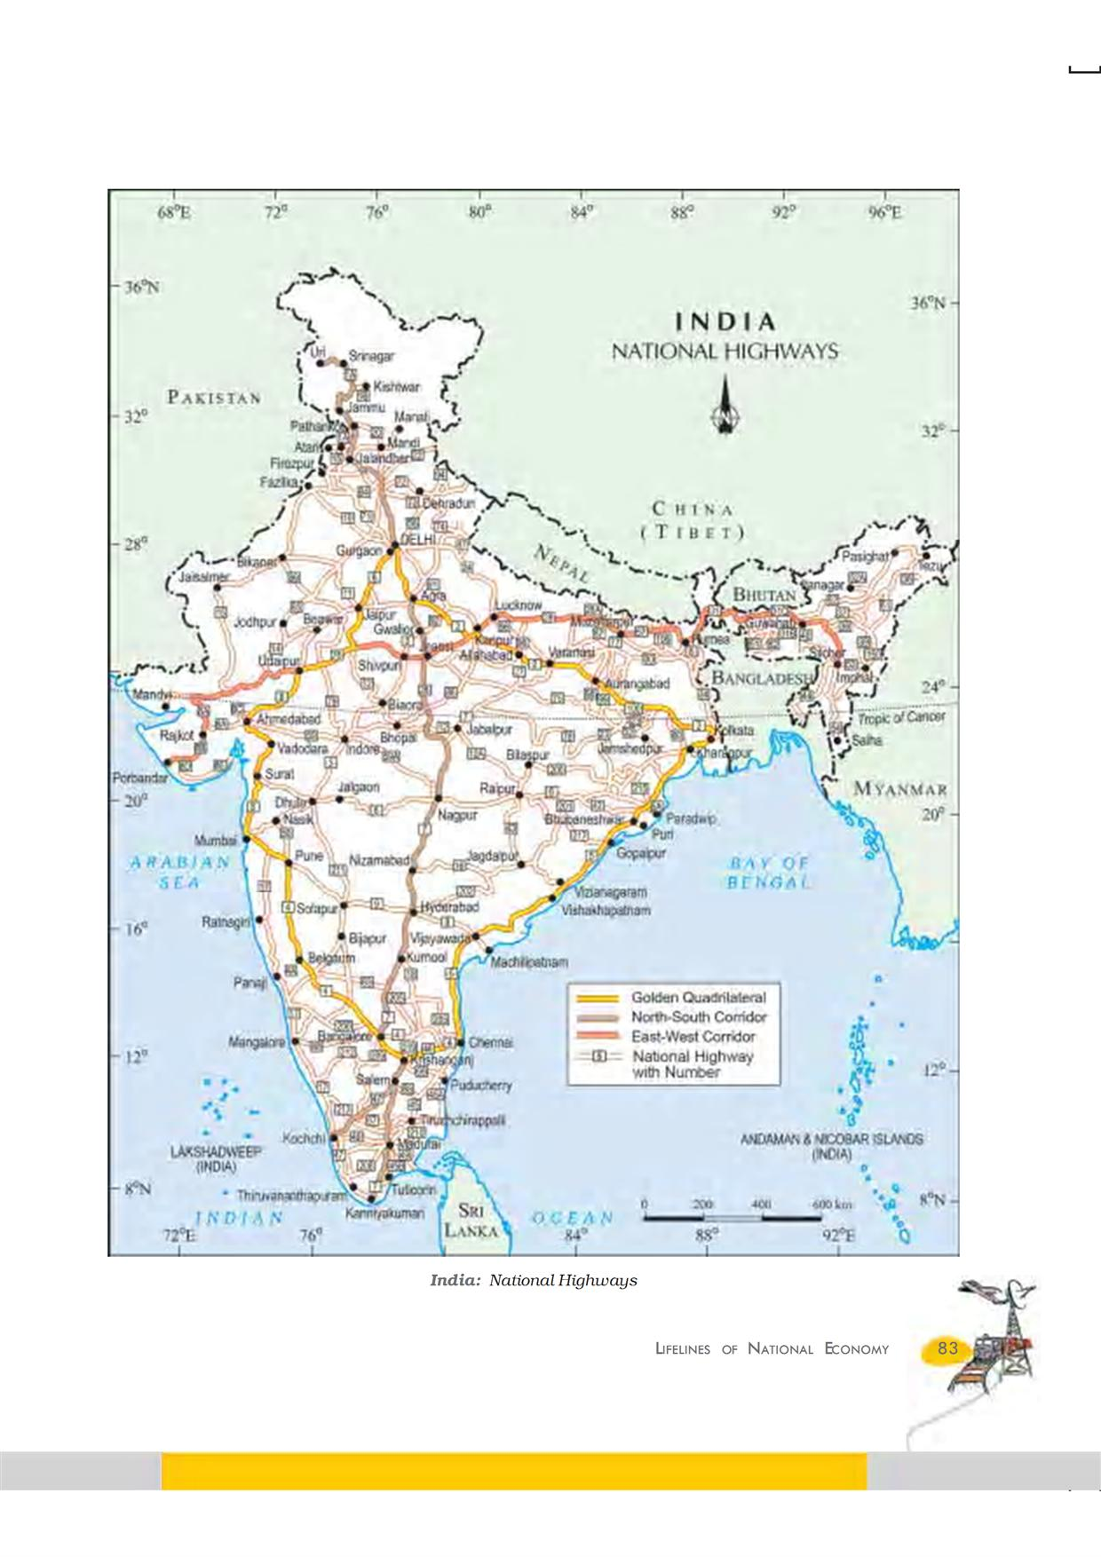
National Highways

Slide 13
(ii) Railways
Railways are the principal mode of transportation for freight and passengers in India. Railways also make it possible to conduct multifarious activities like business, sightseeing, pilgrimage along with transportation of goods over longer distances. The Indian railway have a network of 7,031 stations spread over a route length of 63,221km.The Indian Railway is now reorganised into 16 Zones. The distribution pattern of the railway network in the country has been largely influenced by physiographic, economic and administrative factors. In recent times, the development of Konkan railway along the west coast has facilitated the movement of passengers and goods in this most important economic region of India. It has also faced a number of problem such as sinking of track in some stretches and land slides Today the railways have become more important in our national economy than all other means of transport put together. However, rail transport suffers from certain problems as well. Many passengers travel without tickets. Thefts and damaging of railway property has not yet stopped completely. People stop the trains, pull the chain unnecessarily and this causes heavy damage to the railway.

Slide 15
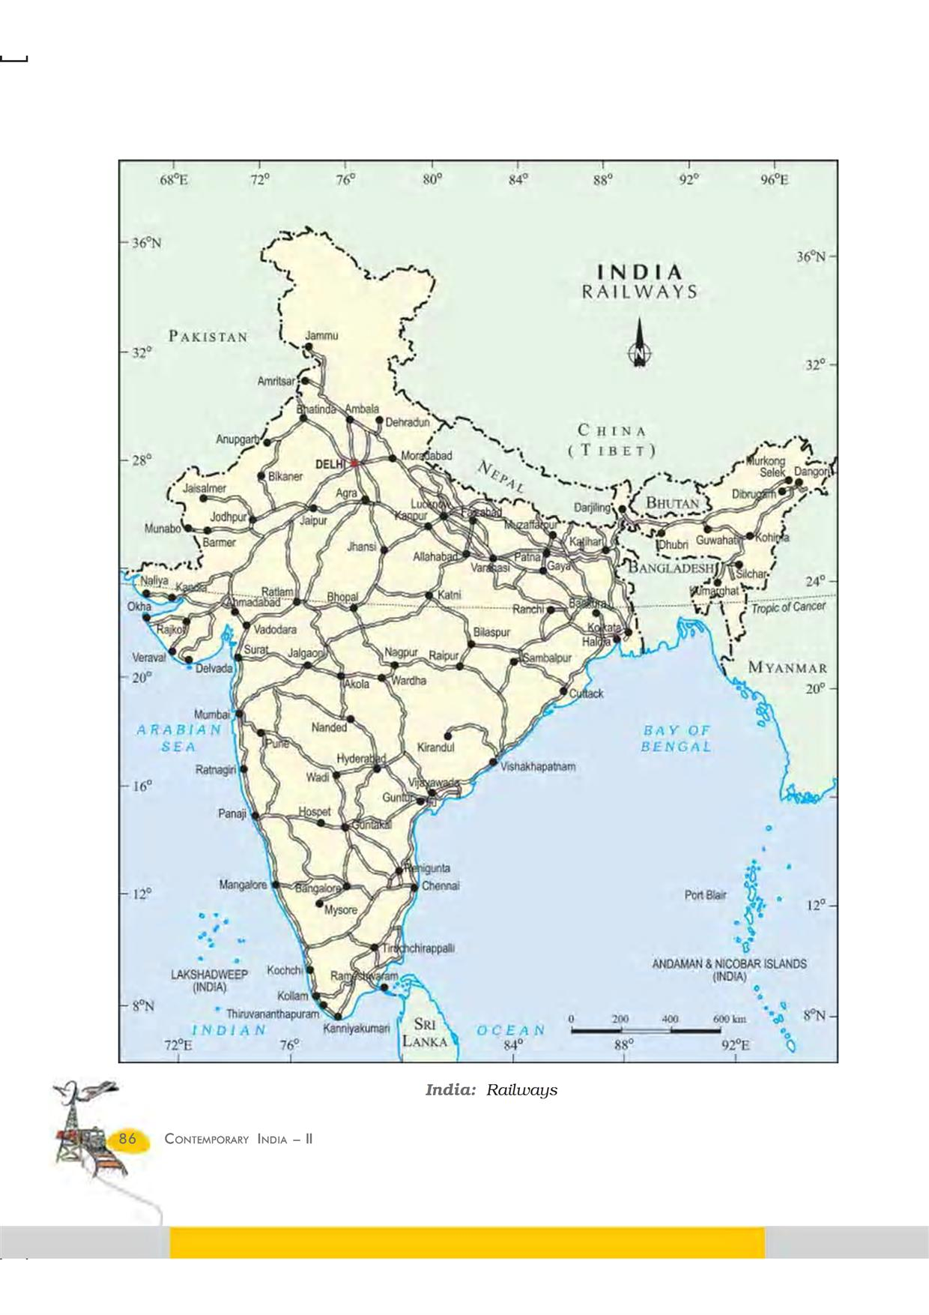
railways

Slide 16
(iii) Pipelines
Pipeline transport network is a new arrival on the transportation map of India. In the past, these were used to transport water to cities and industries. Now , these are used for transporting crude oil, petroleum products and natural gas from oil and natural gas fields to refineries, fertilizer factories and big thermal power plants. Initial cost of laying pipelines is high but subsequent running costs are minimal

Slide 17
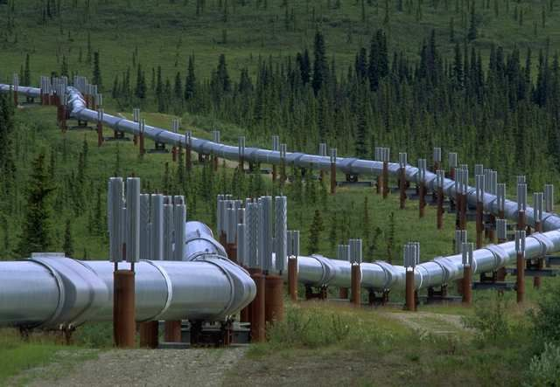

Slide 18
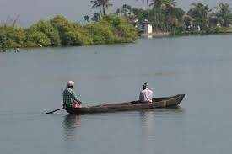
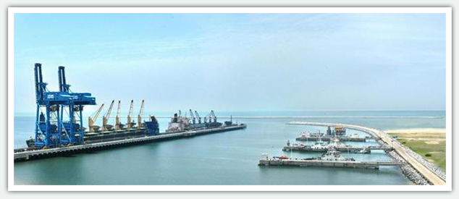
Waterways

Slide 19
Waterways= Waterways are the cheapest means of transport. They are most suitable for carrying heavy and bulky goods. It is a fuel-efficient and environment friendly mode of transport

Slide 20
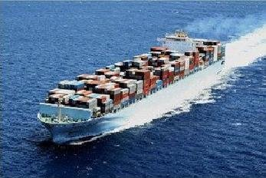
Inland Waterways
India has inland navigation waterways of 14,500km in length. Out of these only 3,700km are navigable by mechanised boats. The following waterways have been declared as the National Waterways by the Government.
*The Ganga river between Allahabad and Haldia(1620km)-N.W.No.1
*The Brahmaputra river between Sadiya and Dhubri(891km)-N.W.No.2
*The West-Coast Canal in Kerala(205km)-N.W.No.3

Slide 21
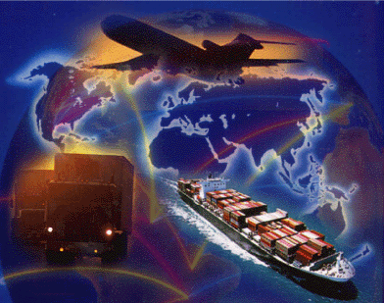
Overseas shipping
With a long coastline of 7.516.6km, India is dotted with 12 major and 181 medium and minor ports. These major ports handle 95 % of india's foreign trade
*Kandla in Kuchchh was the first sea port
*Mumbai is the biggest port with a spacious natural and well sheltered harbour.
*Marmagao port(GOA) is the premier iron ore exporting port of the country.
*New Mangalore port, located in Karnataka caters to the export of iron ore
*Kochchi is the extreme south western port

Slide 22
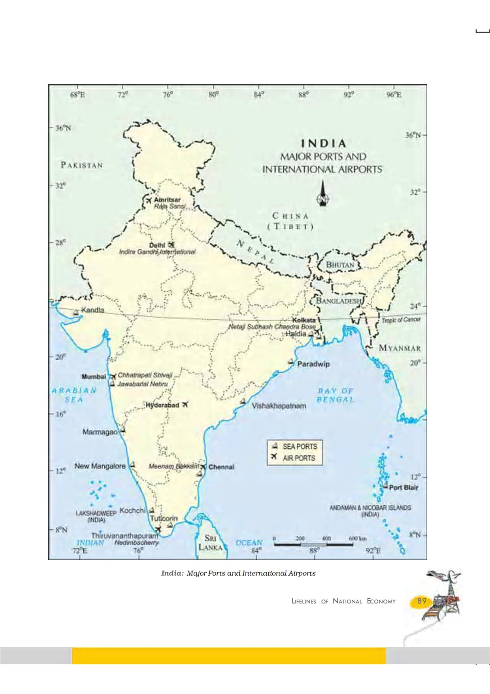
Major ports and international airports

Slide 23
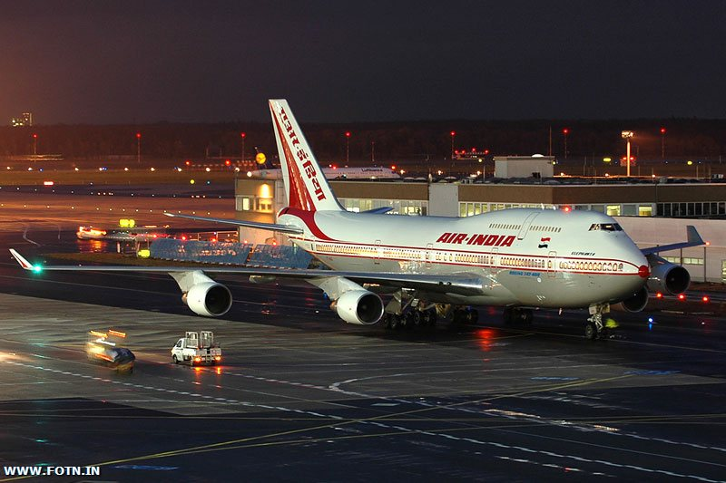
AIRWAYS

Slide 24
Airways=the air travel today is the fastest most comfortable and prestigious mode of transport. It can cover very difficult terrains like high mountains, dreary deserts, dense forests and also long sea stretches with great ease

Slide 25
Types Of Airways
International airports
2) Domestic airports

Slide 26
International Airports
Delhi, Mumbai, Kolkata, Chennai, Thiruvananthapuram, Bangalore, Amritsar, Hyderabad, Ahmedabad, Panaji,Guhawati and Cochin

Slide 27
Domestic Airport
There are 63 domestic airports in India
Airports are managed by the Airports authority of India

Slide 28
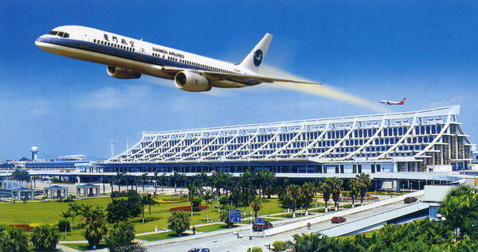

Slide 29
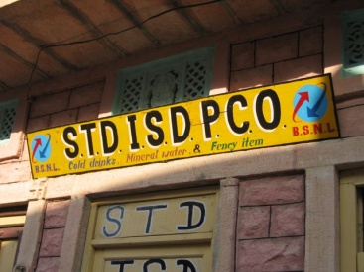
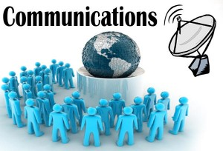
COMMUNICATION
These the process of the communication is very cheap and easy we should communicate with the other in too many short time following are the mean of the communication that are used today to communicate with each other 1. Email 2. internet 3. phone 4. letters 5. Faxes 6. news papers 7. Pumplifts 8. baners 9. signboards on the road 10. news groups

Slide 30
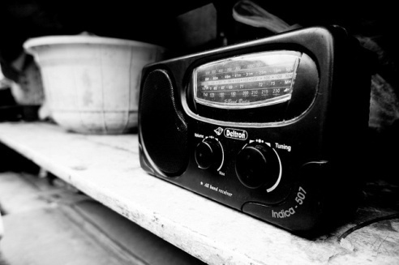
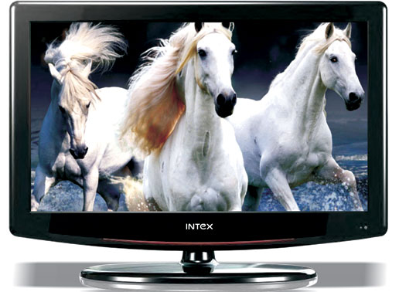
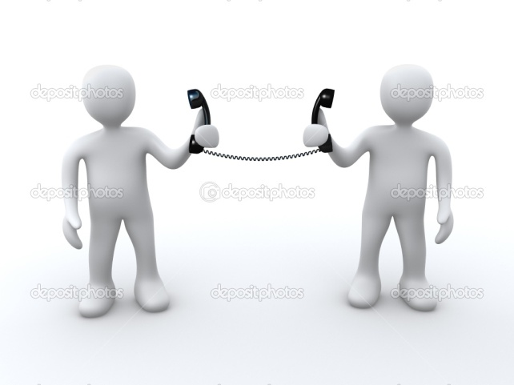

Slide 31
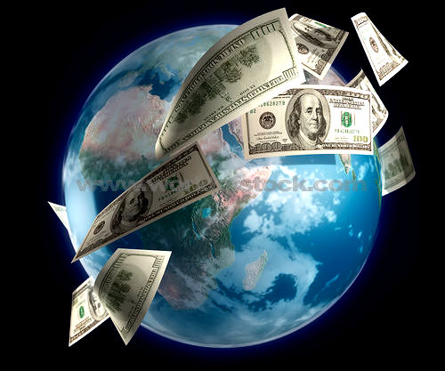
INTERNATIONAL TRADE
Trade between two countries is called international trade. It includes exchange of commodities, services, information and knowledge
Relation or difference between nation's exports and imports is called balance of trade.
1)No country can survive without international trade because resources are space bound
2)Advancement of international trade of a country leads to its economic prosperity because such as trade provides so many jobs to workers as well as business to traders
3)It is through International trade that we earn much of our foreign exchange which is required for importing many essential goods
4)Foreign Trade helps in transfer of technology

Slide 32
TOURISM AS A TRADE
Tourism comprises the activities of the people traveling to and staying outside their usual environments for more than one consecutive day for leisure, business and other purposes. Tourists visit other places for heritage tourism, religious activities, eco tourism, adventure tourism, cultural tourism, medical tourism and business tourism

Slide 34
Important Questions
1) What are the advantages of Tourism industry?
Ans: 1) Provides job opportunity.
2)Promotes national integration
3)Supports local handicraft industries and local cultures
4)helps in cultural interaction and exchange
5)helps to earn foreign exchange
2)What are the problems faced by Indian Roadways?
Ans:1)Road network is inadequate for increasing traffic
2)About half of the roads are unmetalled
3)The national highways are inadequate and poorly maintained
4)The roadways are highly congested in cities
5)lack of proper safety measures

Slide 35
3)What are the advantages of transport?
Ans :1)facilitates easy and free movement of people from one place to another place
2)Helps to carry goods and materials from one place to another
3)helps in production and distribution of goods
4)connect markets with the production centres
5)promotes easy accessibility of goods and services
4)What are the different types of roads in India?
there are six types of roads in India
Ans:1)golden quadrilateral super highways
2)national highways
3)state highways
4)district highways
5)rural roads or village roads
6)border roads
5)What do you mean by Balance of trade?
Ans: Relation or difference between nation's exports and imports is called balance of trade.

