Slide 1
Class 1 EVS
The Sky and the Earth

Slide 2
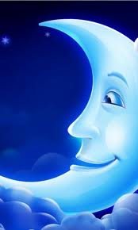
Things in the sky
sun
MOON
STARS
EARTH

Slide 3
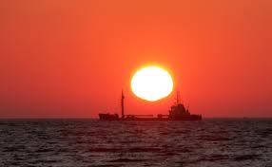
SUN
A big ball of fire

Slide 4
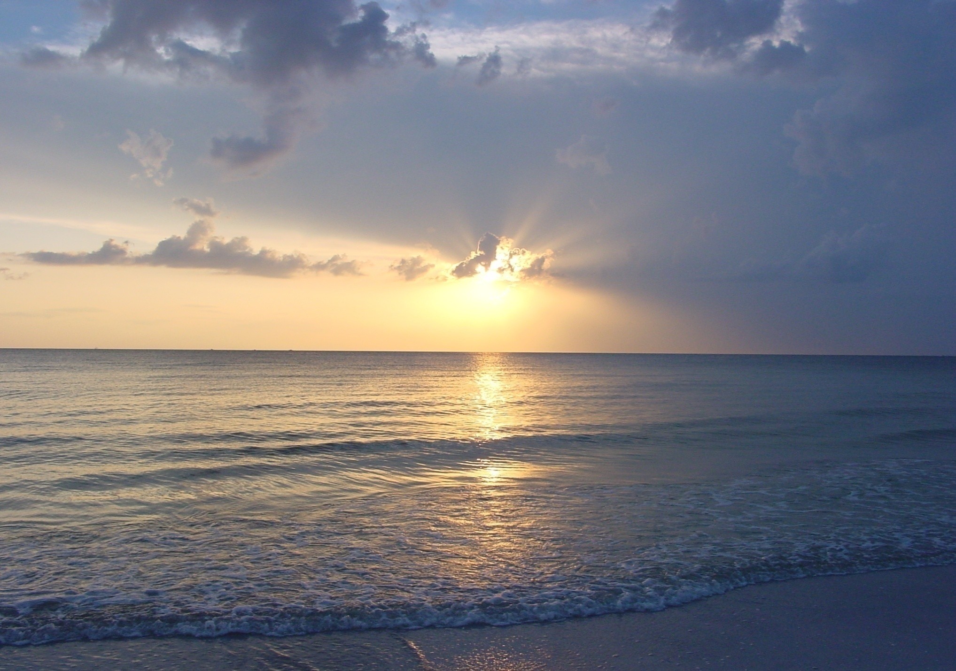
SUN
Rises in the east and sets in the west.
Gives us heat and light.

Slide 5
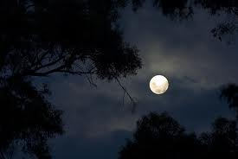
MOON
See at night.
Has no light.
Gets light and heat from sun

Slide 6
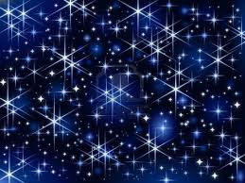
STARS
See at night.
Large number of them are there.
Very far away from us.

Slide 7
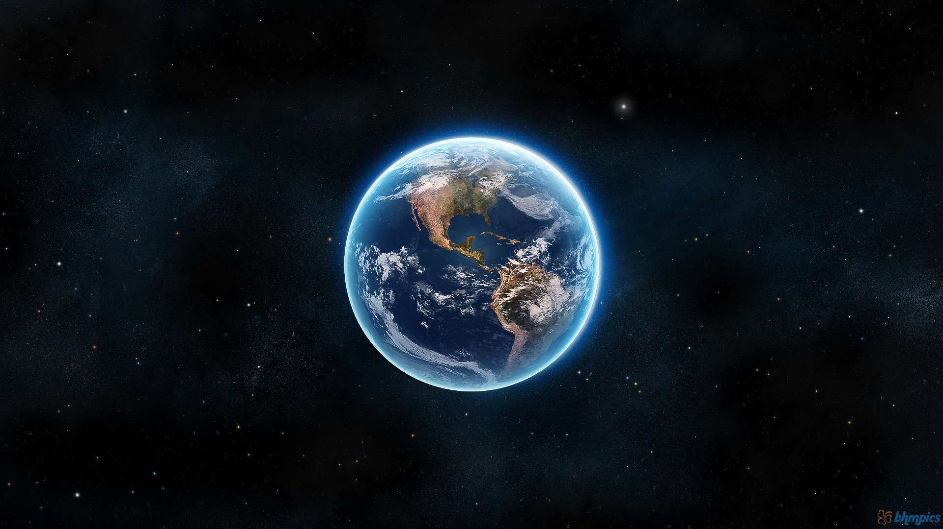
earth
Home of all living thing.
Round in shape.
Made up of land and water.

Slide 8
Fill in the blanks.
stars
earth
sun
We can not count the number of -------------
All living things can be seen on ----------------
The moon gets light from -----------------------
------------------------- is the big ball of fire.
----------------- is made up of land and water.
Sun
Earth

