Slide 1
CONTROL
AND
CO-ORDINATION

Slide 2
NERVOUS SYSTEM
Nervous System is a system which control and coordinate various activities of our body.
It mainly consists of 3 parts:-
Brain
Spinal cord
Nerves.

Slide 3
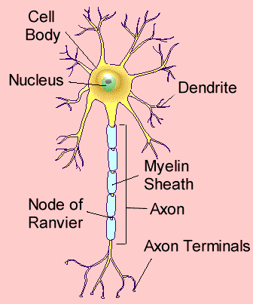
Nerve Cell
Nerve cell is the structural and functional unit of the nervous system.
It is the longest cell in the body.

Slide 4
Receptors
Receptors are the sense organs which receive stimuli from the external environment and send to the brain through nerves.
RECEPTORS and their SENSE ORGANS
Thigmo receptor → Touch
Olfactory receptor → Smell
Photo receptor → Vision/Sight
Gustatory/Tango receptor → Taste
Phono/audio receptor → Sound

Slide 5
STRUCTURE and FUNCTION of NERVE CELL
STRUCTURE:-
A nerve cell has a central body called cyton which contains a nucleus and cytoplasm. There are some finger like projections arising from the cyton called dendrons. The branches of these dendrons are known as dendrites. One of the dendrons is very long, known as axon. The axon is covered by a protective sheath known as myelin sheath. The branches of axon are called axonites/nerve endings.

Slide 6
FUNCTION:-
The dendrites carry the message or information to the cyton. The cyton transmits the impulses through the axon to the axonites and then to other nerve cells. Finally, to the brain and effector organs like muscles and glands.

Slide 7
Pathway of Nerve Impulses
The dendrites of a nerve cell present in the receptor organ detect the external stimuli.
The dendrites, thus, set off a chemical reaction [oxidation (e-)] and that creates or generates electrical impulses.
These electrical impulses then transmit to the cyton.
From cyton, it is transmitted through axon to axonite.
The tip of the axonites release some chemicals.

Slide 8
These chemicals (acetyl chlorine) diffuse across synaptic cleft and reaches the dendrite of another nerve cell and send the electrical impulse.
Finally, it reaches the brain and back to the effector organs such as muscles and glands

Slide 9
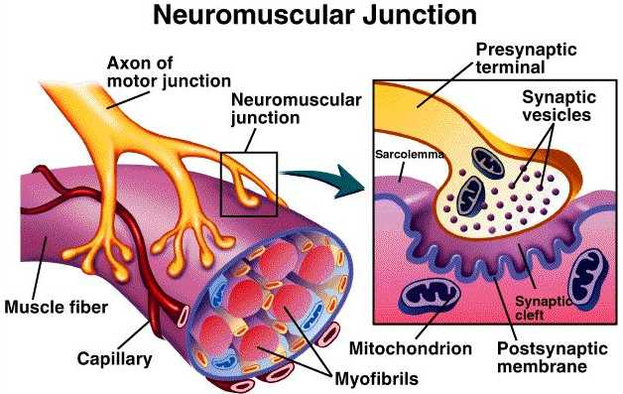

Slide 10
BRAIN
DENDRITE OF ANOTHER NERVE CELL
EXTERNAL STIMULI
EFFECTOR ORGAN (MUSCLES & GLANDS)
SYNAPSE
RECEPTOR ORGAN
AXONITE
AXON
RECEPTOR (TIP OF DENDRITE)
CYTON
DENDRITE

Slide 11
SYNAPSE:-
The gap between the axonites of one nerve cell and the dendrites of another nerve cell is called synapse.
The acetyl chlorine released into the synaptic cleft convert the electrical impulses into chemical impulse and transmit the message from one neuron to another neuron and so on to the brain.

Slide 12
REFLEX ACTION
A quick, spontaneous, involuntary action in response to certain stimuli is called reflex action.
Eg:-
Withdraw of hands when a hot or cold object is touched.
Knee jerk.
Coughing.
Sneezing.

Slide 13
Reflex action is a life saving emergency action in which the nerve cells send the message only up to the spinal cord and not to the brain. The spinal cord takes the decision and send the message back to the effector again.

Slide 14
Reflex Arc
The route of the nerve impulse in a reflex action is called reflex arc.
Nerves from all over the body meet in a bundle in the spinal cord on their way to brain. Reflex arcs are formed in this spiral cord itself, although the information input also goes on to reach the brain.
Reflex arcs in animals have evolved as efficient ways of functioning, as animal brain is not fast enough.

Slide 15
REFLEX ARC
STIMULUS (MESSAGE)
RECEPTOR
SPINAL CORD
EFFECTOR (MUSCLE/GLAND)
ACTION/ RESPONSE

Slide 16
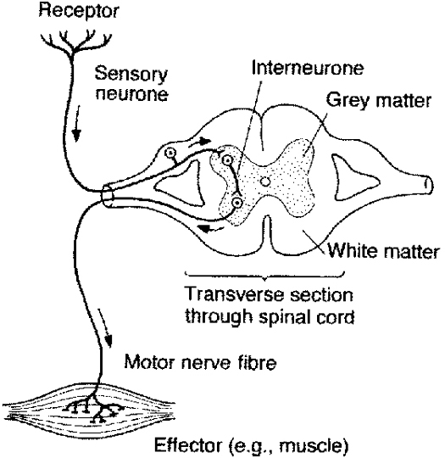

Slide 17
SENSETORY NERVE:
The nerve which carry message from the receptor organs to the brain or spinal cord is called a sensory nerve.
MOTOR NERVE:
The nerve which carry message from the brain or spinal cord to the effector organs is called a motor nerve.

Slide 18
STRUCTURE and FUNCTION of THUMAN BRAIN
The human brain is the highest coordinating centre of the body. The brain is protected by skull bone (cranium). This brain is covered by 3 layers called meninges. The brain consists of three regions:-
FOREBRAIN
It consists of cerebrum which is the brain. It has got many twists and turns. A longitudinal tissues divides the cerebrum into 2 hemispheres. These 2 cerebrals hemispheres are connected by a thick band of nerve fibers called Corpus.

Slide 19
Callosum. The cerebrum has 4 specific Cobes:-
Frontal Cobe (controls muscular activities).
Parietal Cobe (controls touch, smell, temperature and consciousness).
Occipital Cobe (controls centre of visual perception).
Temporal Cobe (controlling centre of auditory perception).
Functions of cerebrum:
Cerebrum is the controller of intelligence, memory, reasoning, judgement, personality, consciousness, etc. It controls all voluntary actions.

Slide 20
MID-BRAIN
It connects the forebrain and hind brain. It also controls audio visual perceptions.
HIND BRAIN
It consists of 3 parts:-
Pons:
It is the proximal (upper) end of medulla. It coordinates the two cerebella hemispheres. It also regulates respiration.
MEDULLA
It is the proportion between pons and spinal cord. It is the controlling centre of all involuntary actions such as coughing, sneezing, yawing ,

Slide 21
heartbeat, breathing, contraction and relaxation of blood vessels, ciliary muscles action, blinking, etc.
Cerebellum:
It is the inner most/hind most part of the human brain. It is the controlling centre of maintaining the posture and balance of the body.
Hypothalamus and pituitary glands are situated in the lower side of the brain. The continuation of medulla is known as spinal cord.

Slide 23
PLANT HORMONES (Phyto hormones)
The chemical substance synthesized by the plants in very small amounts which regulate the growth and other physiological processes.
They are synthesized either at the tip of shoot or root. They migrate to the place or part of the plant body where it is required.

Slide 24
HORMONES in PLANTS
The important plant hormones are:-
AUXIN:-
It initiates growth of shoot and root. Hence, it is known as the growth hormone in plants.
It helps the plants to bend towards external stimuli such as light, water, gravity, touch, etc.
GIBBERELLIN:-
It initiates the growth of the stem.

Slide 25
It induced parthenocarpy (fruits without seeds).
It induced flowering.
It prevents ageing or sene scence.
CYTOKININS:-
It promotes cell division.
ETHYLENE:-
It induces/initiates ripening of fruits.
It induces yellowing of leaves.
It is a gaseous plant hormone.

Slide 26
ABISCISSIC ACID:-
It inhabits growth.
It promotes falling of leaves and fruits (abscission of leaves and fruits).
It inhabits seed germination.
Hormones are also known as chemical messengers.

Slide 27
Tropism/tropic Movement
The movement of a plant body in response to external stimuli is called tropism.
It is of 5 types:-
PHOTOTROPISM:-
The movement of stem towards the direction of light stimulus is called phototropism.
Shoot/stem always show positive phototropism while the root shows negative phototropism.

Slide 28
GEOTROPISM:-
The movement of the plant roots towards the direction of the force of gravity is called geotropism.
Root always show positive geotropism, while the shoot/stem show negative geotropism.
HYDROTROPISM:-
The movement of the plant body towards the direction of the water stimulus.
CHEMOTROPISM:-
Movement of the plant body towards the direction of chemical stimulus.

Slide 29
Eg:-
The growth of pollen tube towards the ovules in the ovary of a flower.
THIGMOTROPISM:-
The movement of a plant body (tendrils) towards the direction of touch stimulus.

Slide 30
EXPERIMENT SHOWING PHOTOTROPISM

Slide 31
Nastic movement
The movement of plant which has no relation with the direction of the stimulus is called nastic movement.
Eg:-
Closing of leaves when we touch touch-me-not.

Slide 32
PHOTOTROPISM

Slide 33
NASTIC MOVEMENT

Slide 34
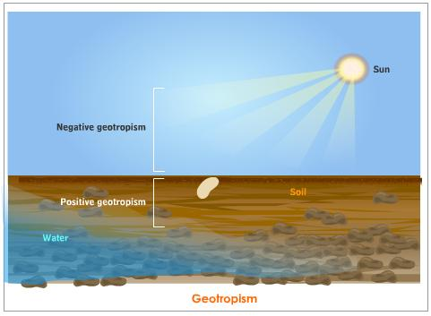
GEOTROPISM

Slide 35
HORMONES in ANIMALS
Hormones are those chemical substances produced or secreted by the endocrine glands which regulate various physiological processes in the body.
In many animals, including human beings, a hormone called adrenalin is secreted from the adrenal glands.
Adrenalin is secreted directly into the blood and carried to different parts of the body. The target organs or the specific tissues on which it acts include the heart.

Slide 36
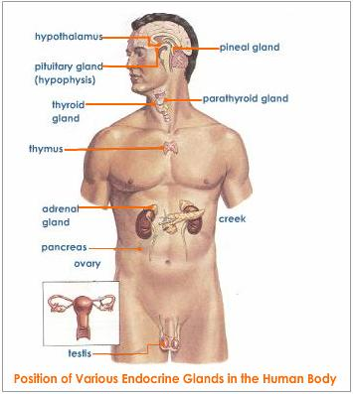
ENDOCRINE GLANDS

Slide 37
As a result, The heart beats faster, resulting in supply of more oxygen to our muscles.
The blood to the digestive system and skin is reduced due to contraction of muscles around small arteries in these organs. This diverts the blood to our skeletal muscles.
The breathing rate also increases because of the contraction of the diaphragm and the rib muscles.
All these responses together enable the animal body to be ready to deal with the situation.
Such animal hormones are of the endocrine system which constitutes a second way of control and coordination in our body.

Slide 38
Insulin
Insulin is a hormone which is produced by the pancreas and helps in regulating blood sugar levels.
If it not secreted in proper amount, the sugar level in the blood rises causing many harmful effects.
If the sugar levels in blood rise, they are detected by the cells of the pancreas which respond by producing more insulin.
As the blood sugar level falls, insulin is reduced.

Slide 39
How does insulin control diabetics?
The insulin hormone converts excess glucose in the blood into glycogen and store in liver. Thus, it reduces the sugar level in blood and prevent diabetics.

Slide 40
Endocrine Glands
The glands which secrete hormones are called endocrine glands.
These glands, which do not have ducts to pass hormones directly discharge the hormones into the blood stream.

Slide 41
HUMAN ENDOCRINE GLANDS, HORMONES and their FUNCTIONS
HYPOTHALAMUS
Neurohormone
It controls the secretions from the pituitary gland.
Controlling centre of our hunger, thirst, emotions and temperature.
Acts as a relay station for the sensory impulses.

Slide 42
PITUITARY GLAND
(As pituitary gland controls all other glands, it is known as master gland of the body.)
H (GGrowth Hormone)
It controls/regulates growth of the body.
The excess secretion of GH leads to a disease called gigantism.
The deficiency of GH leads to a disease known as dwarfinism.
ACTH (Adreno Cortico Tropic Hormone)
ACTH controls the secretion of cortisone by Adrenal gland.

Slide 43
FSH (Follid Stimulating Hormone)
FSH stimulates the production in males and
follicies in the ovary of females.
TSH (Thyroid Stimulating Hormone)
TSH stimulates the production/secretion of thyroxin by the thyroid gland.
ADH (Anti Diuretic Hormone)
ADH stimulates/increases the re-absorption of water and salt from the renal tubules of kidneys.

Slide 44
PINEAL GLAND
(It is known as biological clock of human body.)
Melatonin (Serotonin)
It controls our mood.
It induces sleep.
It acts as an anti-depressive chemical.

Slide 45
THYROID GLAND
(It is the largest endocrine gland in the human body. It is commonly known as the butterfly gland)
Thyroxin
It controls growth and development of the body.
It regulates carbohydrate, protein and fat metabolism in the body (to provide the best balance for health).
The deficiency of the secretion of thyroxin results in a disorder called goiter.

Slide 46
PARATHYROID GLAND
Parathermone
It mobilizes/helps for the absorption of calcium from bones to blood resulting in softening of bones or pore formation in bones (osteoporosis).
It increases the level of calcium in blood and urine.

Slide 47
THYMUS GLAND
Thymosin
Gland found only in children.
It gradually disappear in the adolescent/adult age.
It enhances lymphocytes to develop immunity (to resist disease and injuries).

Slide 48
ADRENAL GLAND
Adrenalin
It is a stress hormone.
The secretion of adrenalin into the blood increases the B.P., heartbeat, breathing rate, stretching of muscle, dialaration of eyes.
It also induces anger, anxiety, excitement, courage and other emotions.
It prepares the body to face emergency situations or conditions. Therefore, it is called fight or flight hormone.

Slide 49
PANCREAS
(It is the second largest endocrine gland in human body. As the gland secretes both enzyme and hormone it is called heterocrine gland)
Insulin
Pancreas is a heterocrine gland. The exocrine part secrets an enzyme-pancreatic juice for digestion of food and the endocrine part secretes insulin hormone.
It controls the level of sugar in blood and prevents the body from diabetics (disease).

Slide 50
TESTIS
Testosterone
It stimulates or enhances spermatogenesis (sperm production) in males.
It initiates the development of secondary sexual characters in males.

Slide 51
OVARY
Oestrogen
It stimulates or enhances ovulation, implantation of pregnancy, child birth, lactation, etc. in females.
It induces secondary sexual characters in females.

Slide 52
PRESENTED BY
P.V.MANOHARAN
KV NO1 CPCRI KASARAGOD

