Slide 1
CLASS 1 ENGLISH
PREPARED BY SMT. T.P.BINDU HEADMISTRESS
K.V.NO.2 KASARAGOD

Slide 2
NEW WORDS
bright
favourite
indigo
rainbow
violet

Slide 4
inside
outside

Slide 5
NAME THE SEVEN COLOURS OF THE RAINBOW

Slide 6
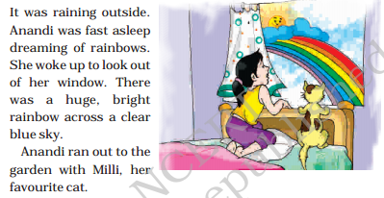

Slide 7
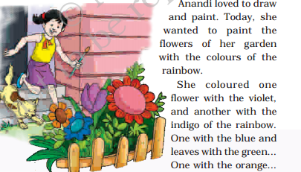

Slide 10
NOW ANSWER THESE QUESTIONS:

